Slide 1
Chapter 3
Block Ciphers and Data Encryption Standard

Slide 2
Stream Ciphers
A symmetric encryption algorithms in which ciphertext output is produced bit-by-bit or byte-by-byte from a stream of plaintext input.
They operate on streams of plaintext & ciphertext one bit/byte at a time.
Stream ciphers convert plaintext to ciphertext one bit at a time.
They encrypt individual characters (usually binary digits) of a plaintext message one at a time, using an encryption transformation.
A key stream generator (sometimes called a running-key generator) outputs a stream of bits: k₁, k₂, k₃,..., k_{i}.
This key stream is XORed with a stream of plaintext bits, p₁, p₂, p₃,..., p_{i}, to produce the stream of ciphertext bits.

Slide 3
The encryption formula is
c_{i}= p_{i} ⊕ k_{i}
At the decryption end, the ciphertext bits are XORed with an identical key stream to recover the plaintext bits.
p_{i}= c_{i} ⊕ k_{i}
If the key stream generator outputs stream of zeros, the ciphertext will equal the plaintext and the whole operation will be worthless.
,,, Cont’d

Slide 4
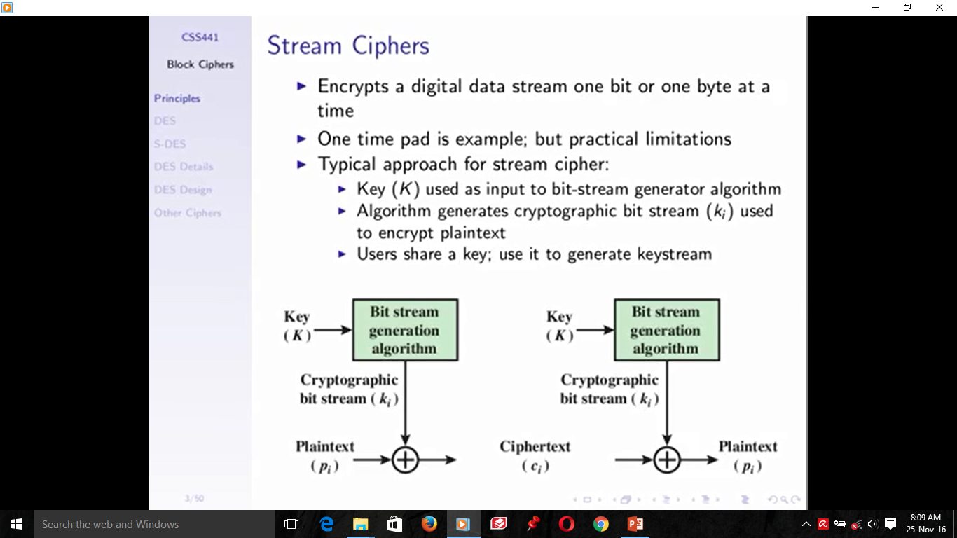
Decryption
Encryption

Slide 5
Block Ciphers
A symmetric encryption algorithms in which a large block of plaintext bits (typically 64) is transformed as a whole into a ciphertext block of the same length.
Block ciphers operate on blocks of plaintext and ciphertext- usually of 64 bits but sometimes longer. The groups of bits are called blocks. For modern computer algorithms, a typical block size is 64 bits.
Block ciphers operate on blocks of a message and apply the encryption algorithm to an entire message block at the same time.
With a block cipher, the same plaintext block will always encrypt to the same ciphertext block, using the same key.
A block cipher is a type of symmetric-key encryption algorithm that changes a fixed-length block of the plaintext into the same length of ciphertext.

Slide 6
A block cipher is an encryption/decryption scheme in which a block of plaintext is treated as a whole and used to produce a ciphertext block of equal length.
It may be viewed as a simple substitution cipher with large character size. The function is parameterized by a k-bit key K, taking values from a subset K (the key space) of the set of all k-bit vectors V_{k}.
It is generally assumed that the key is chosen at random. Use of plaintext and ciphertext blocks of equal size avoids data expansion.
To allow unique decryption, the encryption function must be one-to-one. For n-bit plaintext and ciphertext blocks and a fixed key, the encryption function is a bijection, defining a permutation on n-bit vectors. Each key potentially defines a different bijection.
,,,Cont’d

Slide 7
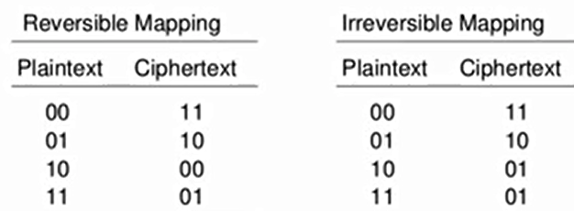
n-bit block cipher takes n bit plaintext and produces n bit ciphertext
2^{n} possible different plaintext blocks (inputs) will be there
Encryption must be reversible (decryption is possible)
Each plaintext block must produce unique ciphertext block
Total transformations (mappings) exist will be 2^{n}!
,,,Cont’d

Slide 8
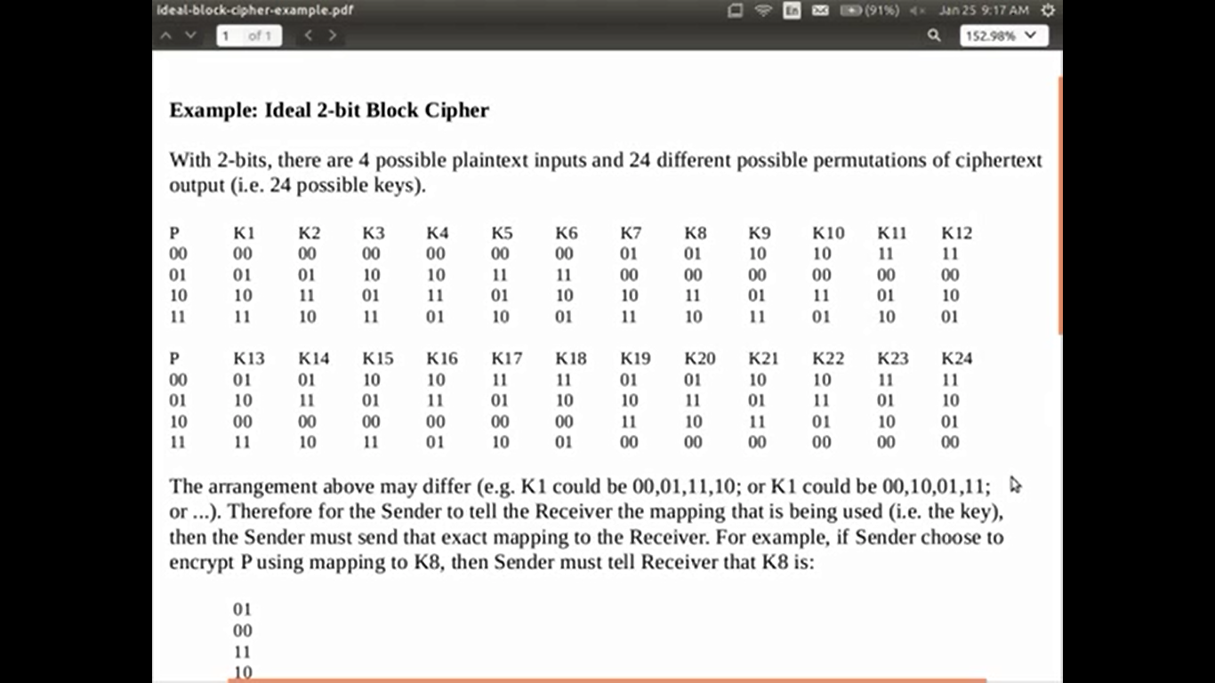
.
,,,Cont’d

Slide 9
Block Ciphers Features
• Block size: in general larger block sizes mean
greater security.
• Key size: larger key size means greater security
(larger key space).
• Number of rounds: multiple rounds offer
increasing security.
• Encryption modes: define how messages larger
than the block size are encrypted, very important
for the security of the encrypted message.

Slide 10
Widely used block Ciphers
Some of the block cipher algorithms widely used today are the following:
DES (Data Encryption Standard)
Double DES
Triple DES
AES (Advanced Encryption Standard)

Slide 11
Data Encryption Standard (DES)

Slide 12
Block Ciphers: Data Encryption Standard (DES)
The Data Encryption Standard, known as DES, is a simple block cipher developed way back in the 1970s.
It is the most widely used encryption scheme.
The plaintext is 64-bits in length, and the key is 56-bits in length
There are 16 rounds of processing. From the original 56-bit key, 16 sub keys are generated, one of which is used for each round.
With a key length of 56 bits, there are 2⁵⁶possible keys, which is approximately 7.2 X 10¹⁶ keys.

Slide 13
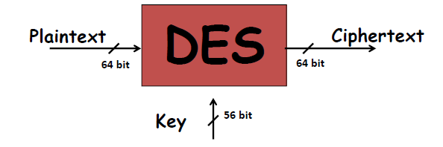
DES Features
Features:
– Block size = 64 bits
– Key size = 56 bits (in reality, 64 bits, but 8 are used as
parity-check bits for error control, see next slide)
– Number of rounds = 16
– 16 intermediary keys, each 48 bits

Slide 14
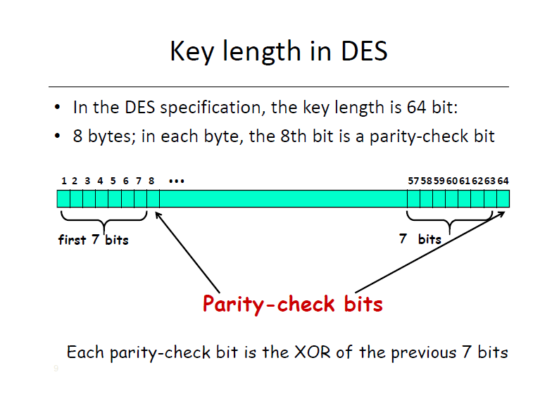

Slide 15
Block Ciphers: DES
Outline of the DES Algorithm
DES operates on two inputs to the encryption function:
a 64-bit block of plaintext to be encrypted and the 56-bit key k.
Note: Actually, the function expects a 64-bit key as input. However, only 56 of these bits are ever used; the other 8 bits (8th, 16th, 24th,…,64th) can be used as parity bits.
The processing of the plaintext proceeds in four phases:
In first phase, the 64-bit plaintext passes through an initial permutation (IP) that rearranges the bits to produce the permuted input. This permuted input is then broken into a right half and a left half, each 32-bits long.
Second phase consists of 16 rounds of an identical operation, called the function F, in which data are combined with the key. This phase consists of sixteen rounds of the same function, which involves both permutation and substitution functions.

Slide 16
Block Ciphers: DES
In each round (see Figure):
The key bits are shifted, and then 48 bits are selected from the 56 bits of the key.
The right half of the data is expanded to 48 bits via an expansion permutation, combined with 48 bits of a shifted and permuted key via an XOR, sent through 8 S-boxes producing 32 new bits, and permuted again.
The output of Function F is then combined with the left half via another XOR.
The result of these operations becomes the new right half; the old right half becomes the new left half. These operations are repeated 16 times, making 16 rounds of DES.
In the third phase, the output of the last (sixteenth) round consists of 64 bits that are a function of the input plaintext and the key. The left and right halves of the output are swapped to produce the preoutput.

Slide 17
Block Ciphers: DES
Outline of the DES Algorithm
In the final phase, the preoutput is passed through an inverse permutation (IP⁻¹) of the initial permutation function, to produce the 64-bit ciphertext.
The right-hand portion of the following Figure shows the way in which the 56-bit key is used.
Initially, the 64 bit key is passed through a permutation function, then 8 bits (k₈,k₁₆,k₂₄,... ,k₆₄) of K are discarded.
Then, for each of the 16 rounds, a 48 bit subkey (K_{i}) is produced by the combination of a left circular shift and a permutation from the 56 bit key.
The permutation function is the same for each round, but a different subkey is produced because of the repeated shifts of the key bits.

Slide 18
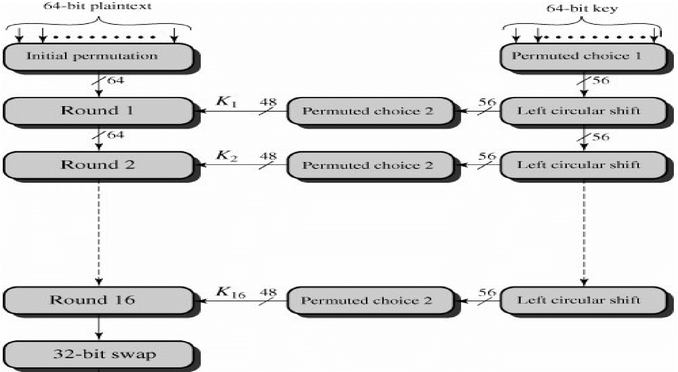
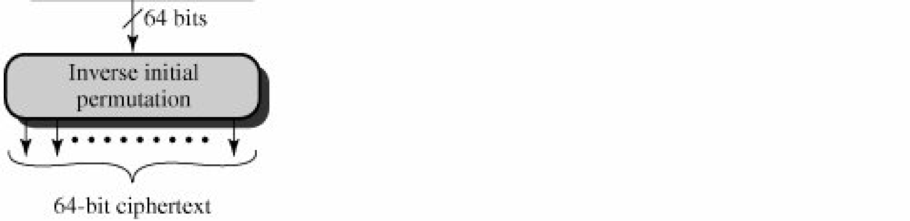
Round 1 input of round 2, round 2 is input of round 3…so on
Figure: General Depiction of DES Encryption Algorithm

Slide 19
Block Ciphers: DES
Outline of the DES Algorithm
With the exception of the initial and final permutations, as shown in the following Figure.
For each round i = 1, 2, . . . , 16, new left and right halves are computed according to the rule
L_{i} = R_{i−1}
R_{i} = L_{i−1} ⊕ F(R_{i−1,}K_{i} )
where K_{i} is the subkey for round i.

Slide 20
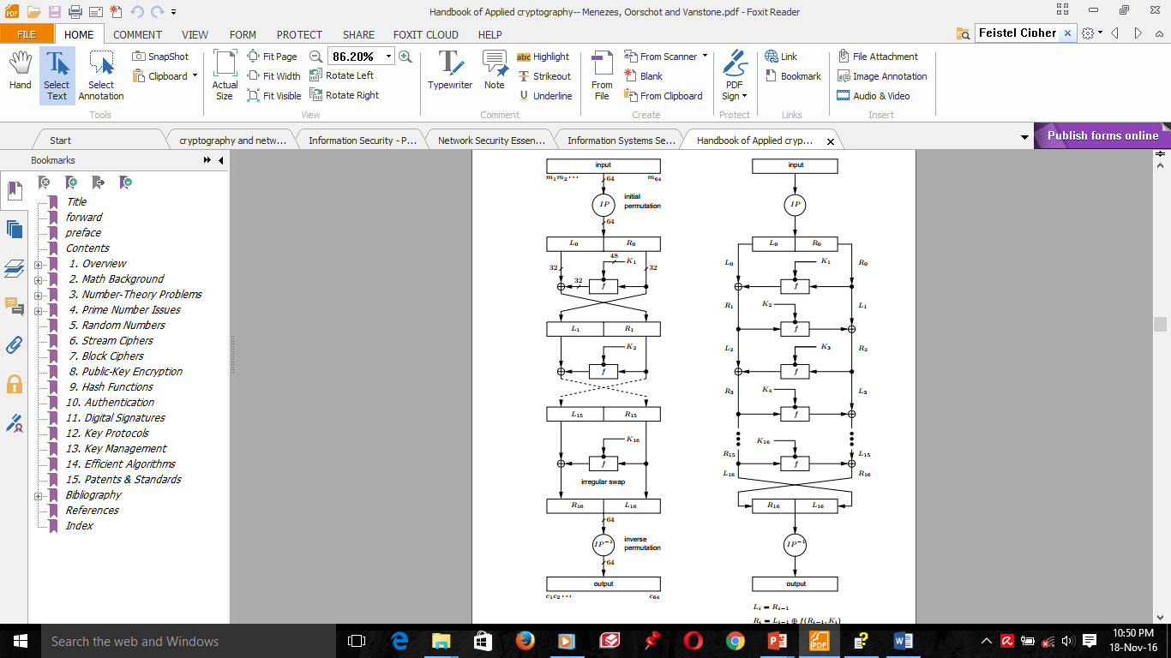
Figure: DES computation path

Slide 21
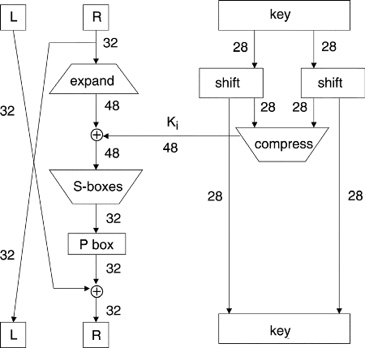
Figure: One round of DES

Slide 22
Block Ciphers: DES
Unscrambling the above diagram, we see that the DES round function F can be written as follows.
F(R_{i−1},K_{i}) = P-box(S-boxes(Expand(R_{i−1})⊕K_{i}))
Since the DES block size is 64 bits, each L_{i} and R_{i} is 32 bits. The new left half is simply the old right half. The round function F is the composition of the expansion permutation, addition of sub key, S-boxes, and P-box.
The expansion permutation expands its input from 32 to 48 bits (all bits are used once; some are used twice), and the 48 bit subkey is XORed with the result.
The S-boxes then compress these 48 bits down to 32 bits before the result is passed through the P-box.
The P-box output is then XORed with the old left half to obtain the new right half.

Slide 23
Block Ciphers: DES: DES FUNCTIONS IN DETAIL
Now let us describe each of the components of F.
1) The Initial Permutation and final Permutation
The initial permutation and its inverse are defined by the following tables.
These tables, like all the other tables in this chapter, should be read left to right, top to bottom.
For example, the initial permutation moves bit 58 of the plaintext to bit position 1, bit 50 to bit position 2, bit 42 to bit position 3, and so forth.

Slide 24
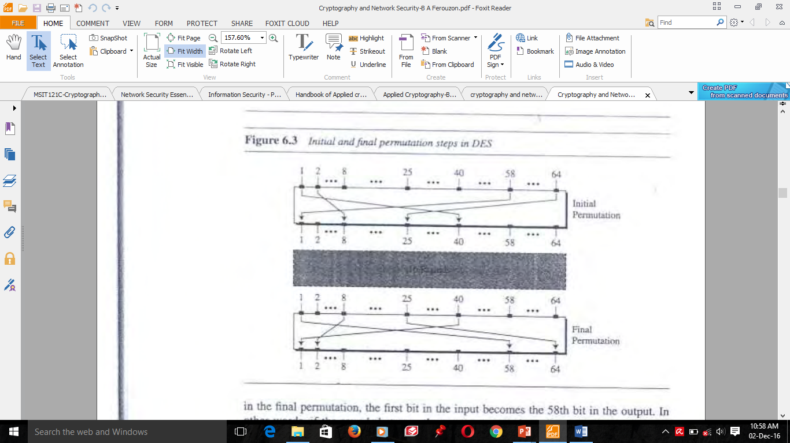
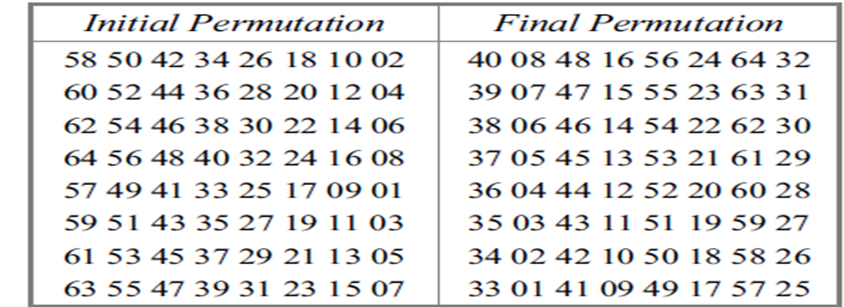
Block Ciphers: DES: DES FUNCTIONS IN DETAIL
Table. Initial and final permutation tables in DES
Figure: Initial and Final permutations in DES

Slide 25
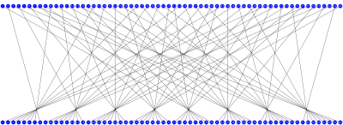
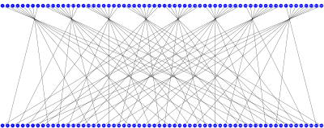
Symmetric DES The P-Box Permutation
Initial Permutation (IP)
Final Permutation (FP)
IP
58 | 50 | 42 | 34 | 26 | 18 | 10 | 2
60 | 52 | 44 | 36 | 28 | 20 | 12 | 4
62 | 54 | 46 | 38 | 30 | 22 | 14 | 6
64 | 56 | 48 | 40 | 32 | 24 | 16 | 8
57 | 49 | 41 | 33 | 25 | 17 | 9 | 1
59 | 51 | 43 | 35 | 27 | 19 | 11 | 3
61 | 53 | 45 | 37 | 29 | 21 | 13 | 5
63 | 55 | 47 | 39 | 31 | 23 | 15 | 7
IP⁻¹
40 | 8 | 48 | 16 | 56 | 24 | 64 | 32
39 | 7 | 47 | 15 | 55 | 23 | 63 | 31
38 | 6 | 46 | 14 | 54 | 22 | 62 | 30
37 | 5 | 45 | 13 | 53 | 21 | 61 | 29
36 | 4 | 44 | 12 | 52 | 20 | 60 | 28
35 | 3 | 43 | 11 | 51 | 19 | 59 | 27
34 | 2 | 42 | 10 | 50 | 18 | 58 | 26
33 | 1 | 41 | 9 | 49 | 17 | 57 | 25
“First Bit of the output is taken from the 58th bit of the input, etc...”

Slide 26
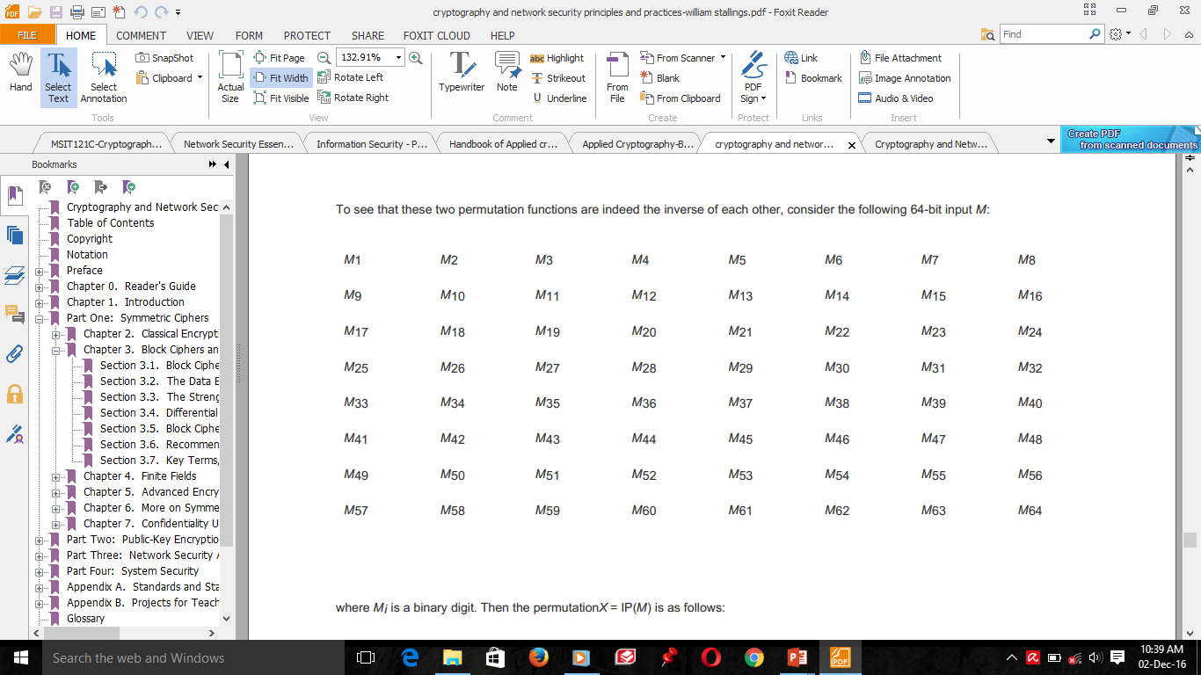
Block Ciphers: DES: DES FUNCTIONS IN DETAIL
The tables are to be interpreted as follows.
The input to a table consists of 64 bits numbered from 1 to 64.
The 64 entries in the permutation table contain a permutation of the numbers from 1 to 64.
Each entry in the permutation table indicates the position of a numbered input bit in the output, which also consists of 64 bits.
To see that these two permutation functions are indeed the inverse of each other, consider the following 64-bit input M, where M_{i} is a binary digit:

Slide 27
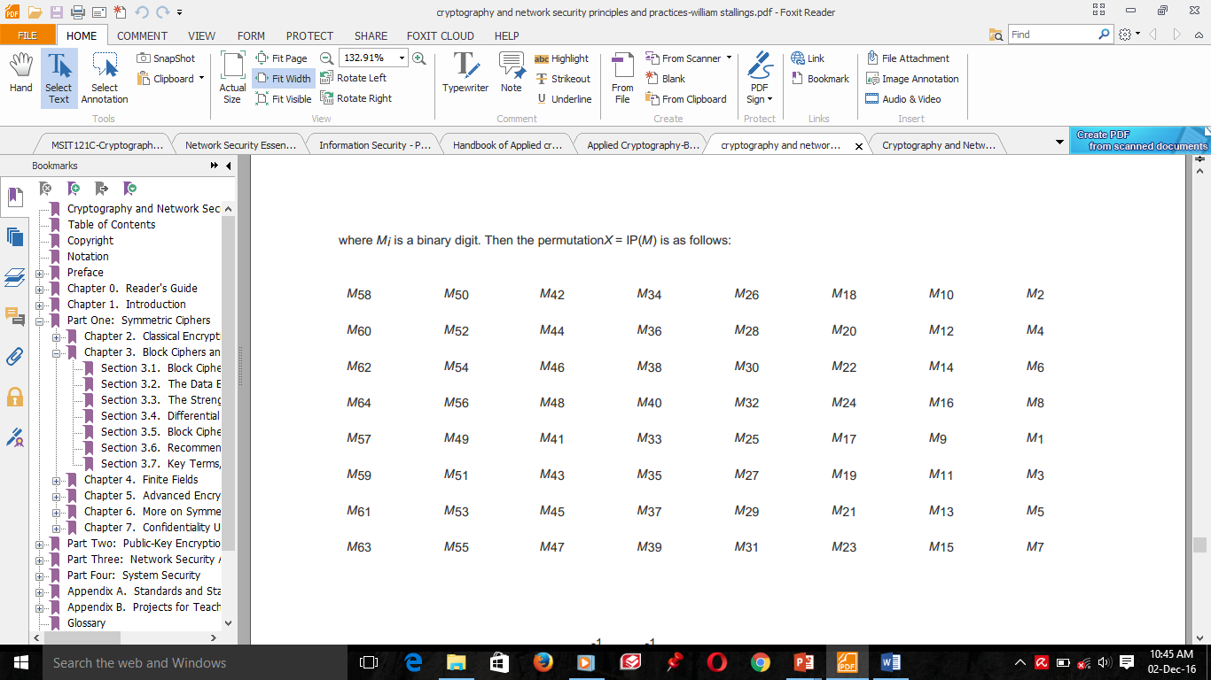
Block Ciphers: DES: DES FUNCTIONS IN DETAIL
Then the permutation X= IP(M) is as follows:
If we then take the inverse permutation
Y= IP⁻¹(X) = IP⁻¹(IP(M)),
it can be seen that the original ordering of the bits is restored.

Slide 28
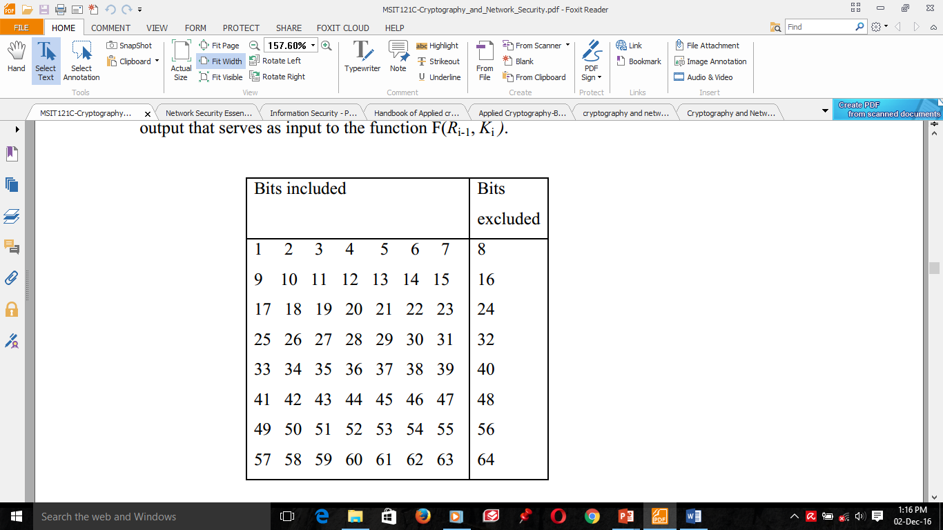
Block Ciphers: DES: DES FUNCTIONS IN DETAIL
2) The Key Generation/Transformation
Returning back to Figures of general depiction and one round of DES, we see that a 64-bit key is used as input to the algorithm. The bits of the key are numbered from 1 through 64; every eighth bit is ignored, as indicated in the following table.
Table: Bits included
and excluded in
reducing the key size

Slide 29
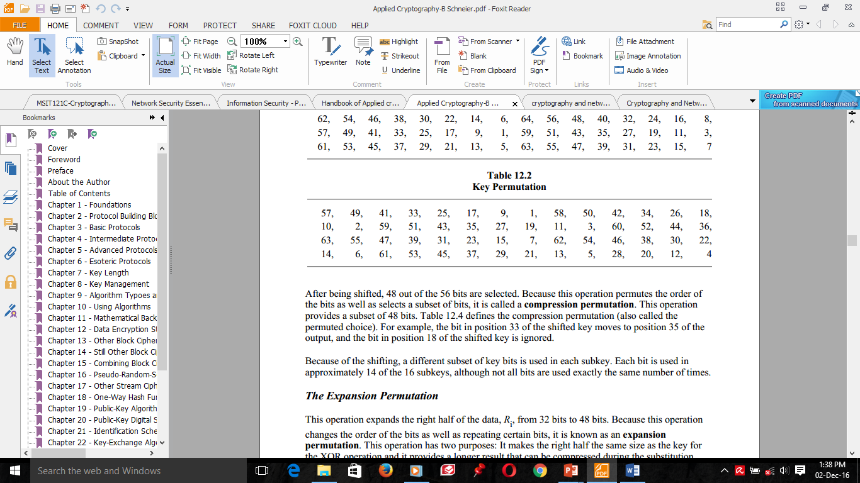
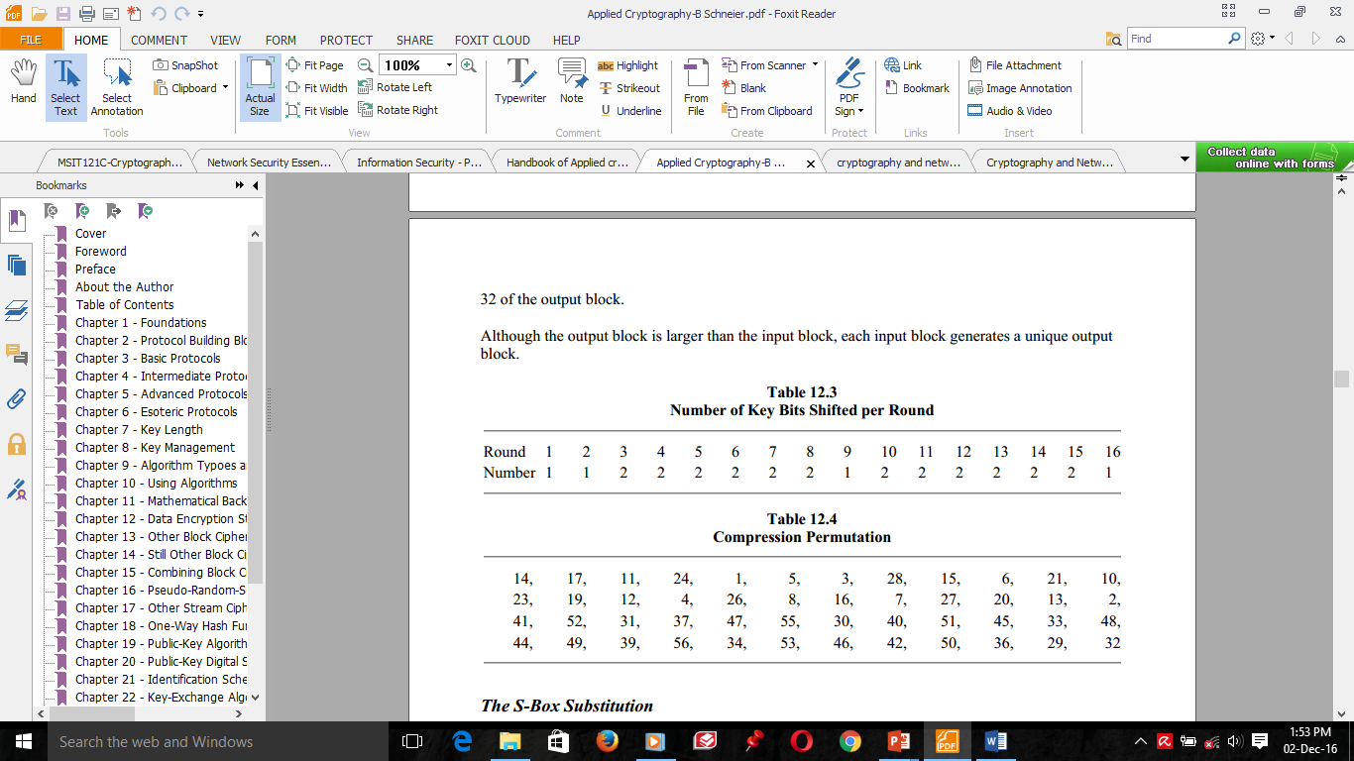
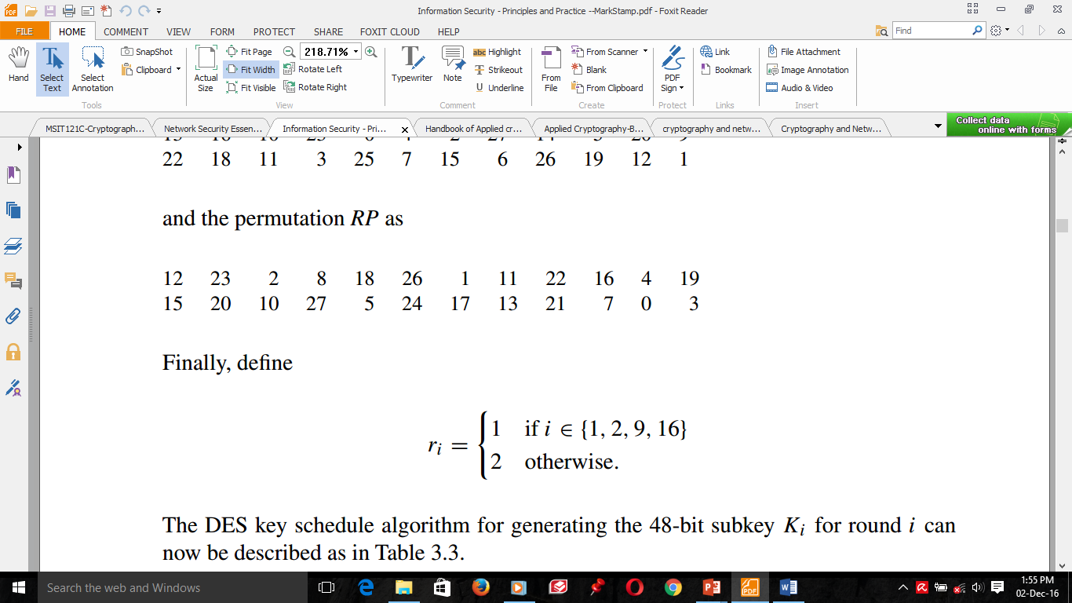
2) The Key Generation/Transformation
The key is first subjected to a permutation governed by a table labeled Permuted Choice One (the following table). This is nothing but permutation of numbers (referring to bit positions) in the left of the previous table.
Table: Permuted Choice One
The resulting 56-bit key is then treated as two 28-bit quantities
Each halves are separately subjected to a circular left shift, or rotation, of 1 or 2 bits, as governed by the following table.
Table : Number of Key Bits
Shifted per Round

Slide 30
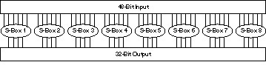
Block Ciphers: DES: DES FUNCTIONS IN DETAIL
3) The S-Box Substitution
After the compressed key is XORed with the expanded block, the 48-bit result moves to a substitution operation.
The substitutions are performed by 8 substitution boxes, or S-boxes.
Each S-box has a 6-bit input and a 4-bit output, and there are 8 different S-boxes.
The 48 bits are divided into eight 6-bit sub-blocks. Each separate block is operated on by a separate S-box: The first block is operated on by S-box 1, the second block is operated on by S-box 2, and so on.
Figure: S-Box Substitution

Slide 31
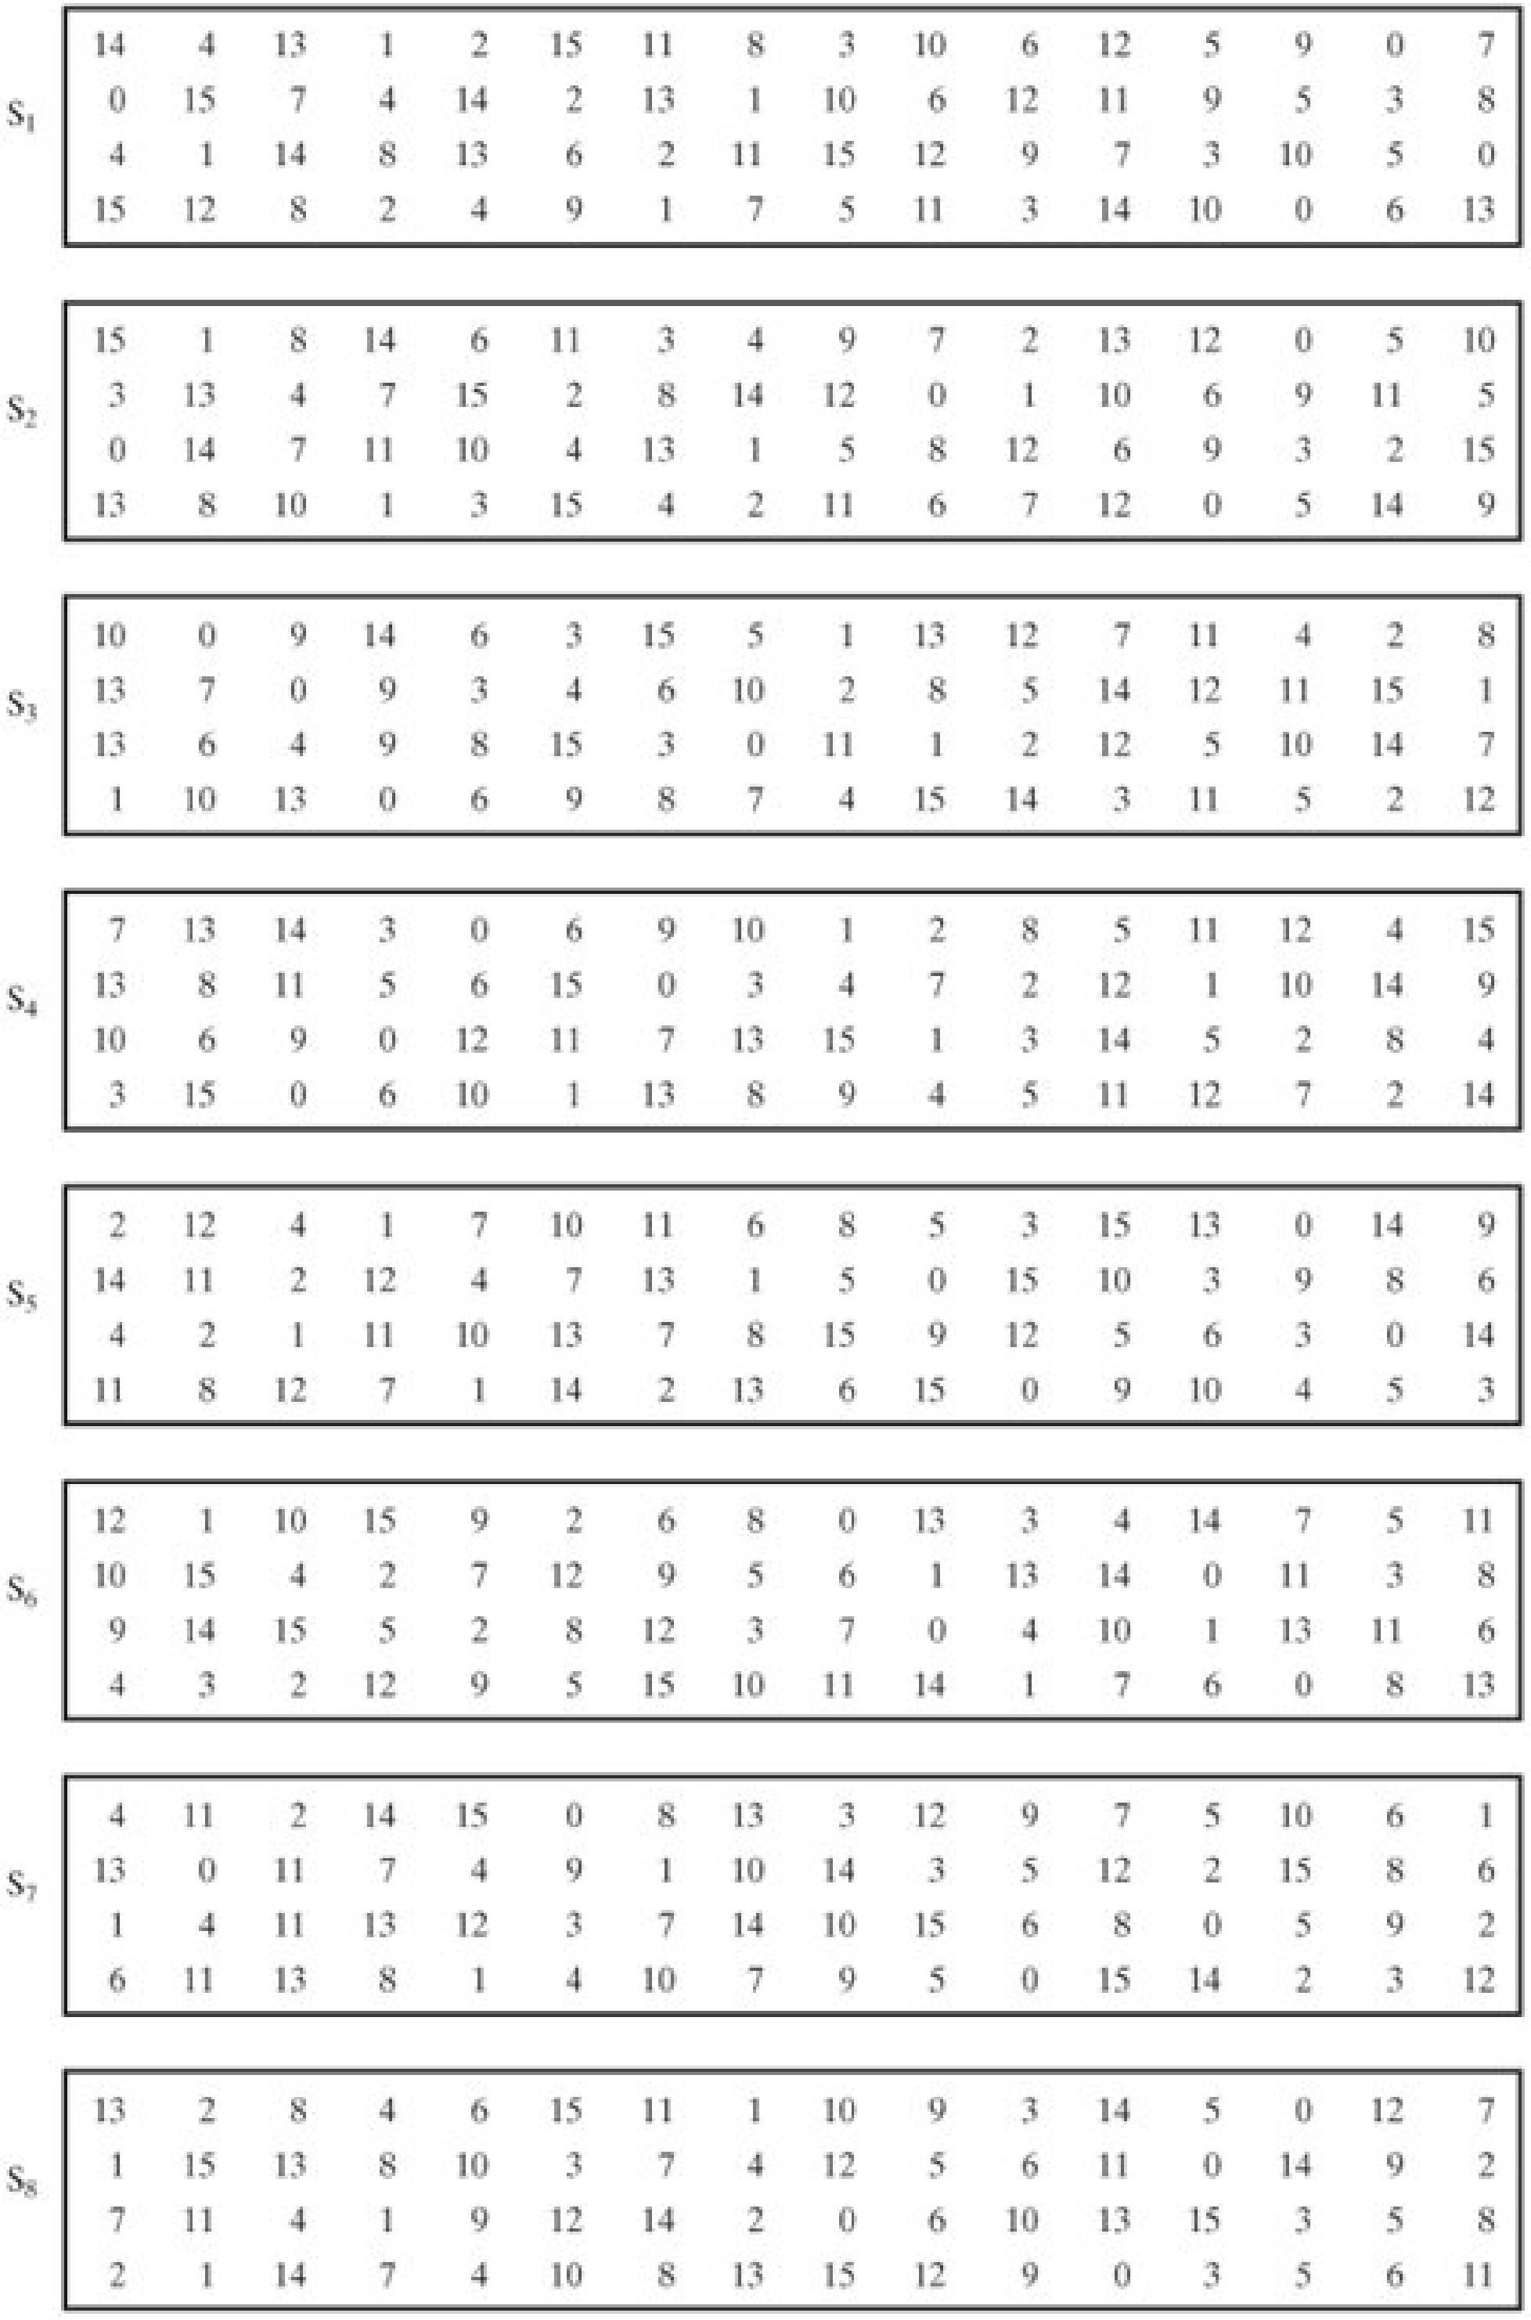
4) The S-Box Substitution
Each S-box is a table of 4 rows and 16 columns. Each entry in the box is a 4-bit number. The 6 input bits of the S-box specify under which row and column number to look for the output.
The following table shows all eight S-boxes

Slide 32
4) The S-Box Substitution

Slide 33
Block Ciphers: Double DES
Let P be a block of plaintext, K a key, and C be ciphertext.
For DES, C and P are each 64 bits, while K is 56 bits.
The notation that we adopt for the encryption of P with key K is C = E(P, K)
while the corresponding decryption is denoted
P = D(C, K)
DES’s key length of 56 bits is insufficient today.
A variant of DES, Double DES, uses key length of 112 bits.
Double DES has a 112-bit key and enciphers blocks of 64 bits.
Here is the double DES encryption:
C = E(E(P, K₁),K₂)
or, P → E(P, K₁) → E(E(P, K₁), K₂) → C
and the double DES decryption:
D(C, K₂) → D(E(E(P, K₁), K₂), K₂) → E(P, K₁).

Slide 34
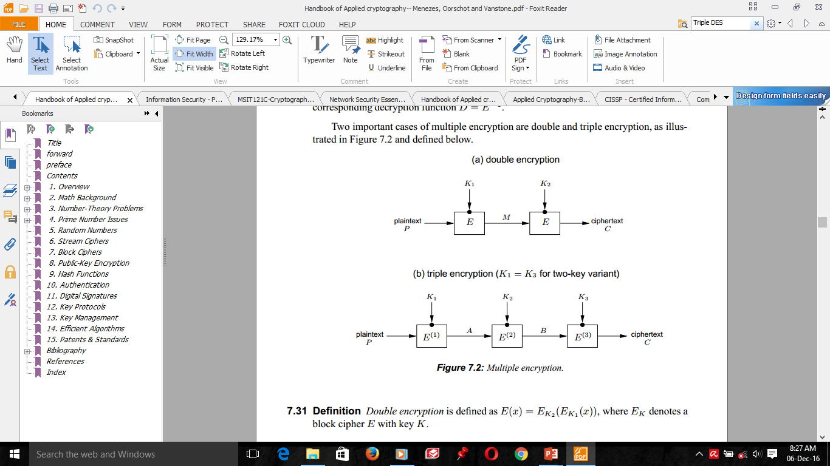
Block Ciphers: Double DES
Figure: Double encryption

Slide 35
Block Ciphers: Triple DES
A popular variant of DES is triple DES, or 3DES.
3DES was developed in 1999 by IBM – by a team led by Walter Tuchman.
3DES has a 168-bit key and enciphers blocks of 64 bits.
The first simply encrypts the plaintext three times, using three different keys: K₁, K₂, and K₃
It is known as DES-EEE3 mode (the Es indicate that there are three encryption operations, where as the numeral 3 indicates that three different keys are used).
DES-EEE3 can be expressed using the following notation, where E(K, P) represents the encryption of plaintext P with key K :
E(K₁, E(K₂, E(K₃, P)))
DES-EEE3 has an effective key length of 168 bits.

Slide 36
THANK
YOU
VERY MUCH!!!

